Slide 1


Small Group Leader Training on Zoom
Session 3: Growing leadership and mission in a small group
Notes:
7.30

Slide 2

Welcome
BREAKOUT: What has helped you to grow as a Christian and as a leader?
Notes:
7.30 Breakout 10 mins

Slide 3

Worship
As the video plays, type into the chat a sentence of thanks or adoration.
https://www.youtube.com/watch?v=Biex1XR_mpo
Notes:
7.45 Briefly introduce, listen and pray

Slide 4

Creating an Atmosphere of Growth
All Involved
Culture of Experimentation
Encouragement
Reaching the Point of Edification
Look and listen for potential
Sort the issues
The Swimming Pool
Notes:
7.40 Feedback and summarise

Slide 5
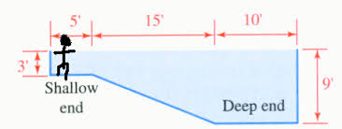
Welcome
The Swimming Pool
BREAKOUT: When have you been given confidence to lead and how did it happen?
Notes:
7,50 Explain

Slide 6
Witness
Look at the Suffolk Discipleship Pathway – and work through a discipleship pathway for a situation you know.
Notes:
815 – Use Harvest as example

Slide 7





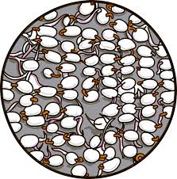

Suffolk
Discipleship Pathway
Sowing
Nurturing
Fruit
Flowering
www.light-wave.org
Based on Sowing, Reaping, Keeping model. (Lawrence Sunglehurst’s acclaimed book of the same name and developed by Fresh Expressions in MSM course.
Notes:
work through an example from the group
Sowing – A small group connects with people and shows the love of God by enjoying mutual interest or meeting a need.
Low spiritual content – wide appeal.
For example: Small team starts Parent and Toddler Group.
Nurturing – People who have been part of sowing can be invited to join an activity which involves opportunity to explore faith at some level (not all may say yes – so smaller size).
For example: Praise and Play offered to the parents in the Parent and Toddler Group; Messy Church.
Flowering – Opportunity to find out in depth about Christianity and to commit. Taken up by fewer people so may join up with other small groups or parish activity to provide this.
For example: Alpha with Toddlers.
Fruit – People continue to grow as disciples within some form of Church which could be a parish church or fresh expression of Church. The word fruit conveys on-going development and giving to others in witness and service.
For example: Parent and Toddler discipleship group grows from Alpha

Slide 8
Witness and Word: Breakout
Share with each other further examples of the Suffolk Discipleship Pathway and seek each other’s help
Read Romans 12.1-8
Which gift strikes you as important for your own service of God. “The point of edification”
Pray for each other that God help you to use this gift
Notes:
8.30

